Slide 1
Presentation Title
Authors’ Name (underline and bold presenter’s name) Affiliation
IF YOU WISH TO SHOW AFFILIATION LOGOS,
PUT THEM ONLY HERE

Slide 2
Purpose of this Presentation
This presentation contains the template and recommended guidelines for electronic slide preparation for ICIMCIS 2023 that will be held virtually on 7th-8th November 2023.
This guideline you are reading has presentation compositions, colors and fonts that make it easy to read and understand
The authors may edit this template and replace this slides with author’s presentation
This guideline also contains the tutorial for taking pre-recording video to be played in the conference.
PAPER ID, SPEAKER NAME, SHORT PAPER TITLE

Slide 3
Typical Presentation Flow (13 -15 slides)
1 slide: Title, Authors and Affiliation
1 slide: Outline of the Presentation
2 - 3 slides: Introduction/Background/Literature/Motivation/
Problem statement/ Challenge
4 – 5 slides: Details of proposed work/ Methodology
(Theory/ simulation/ experiment)
3 – 4 slides: Results/Comparison/Analysis/Recommendation
1 slide: Conclusion
1 slide: Thanks, or Q/A slide
You may add backup slides, if desired
PAPER ID, SPEAKER NAME, SHORT PAPER TITLE

Slide 4
Contrast
Please select carefully the font colors for clear visualization.
The authors will be better use dark color line/text on a light background (e.g. Black, Blue, Red on white background) and avoid Yellow, grey, cyan or any other low contrast color on white background.
Please avoid slow transition of slide/ graphics/ special effects or annoying transition/sound effects.
PAPER ID, SPEAKER NAME, SHORT PAPER TITLE

Slide 5
Recording Narration….
As ICIMCIS 2023 is a Hybrid Conference,
Every Presentation file should be pre-screened by the TPC and then final version of the presentation will be uploaded. Hence, authors are requested to submit the presentation and pre-recorded video to https://bit.ly/Speakers-Material-ICIMCIS-2023 no later than Nov 1st, 2023.
The possible ways of recording could be conducted by:
Record Using MS Power Point (Microsoft 365)
Record Using Zoom
Record Using Techsmith Camtasia
Other recorders
Pre-recorded video is about 10-15 minutes video could not longer than 15 minutes.
You may get help regarding this recording in the next few slides
PAPER ID, SPEAKER NAME, SHORT PAPER TITLE

Slide 6
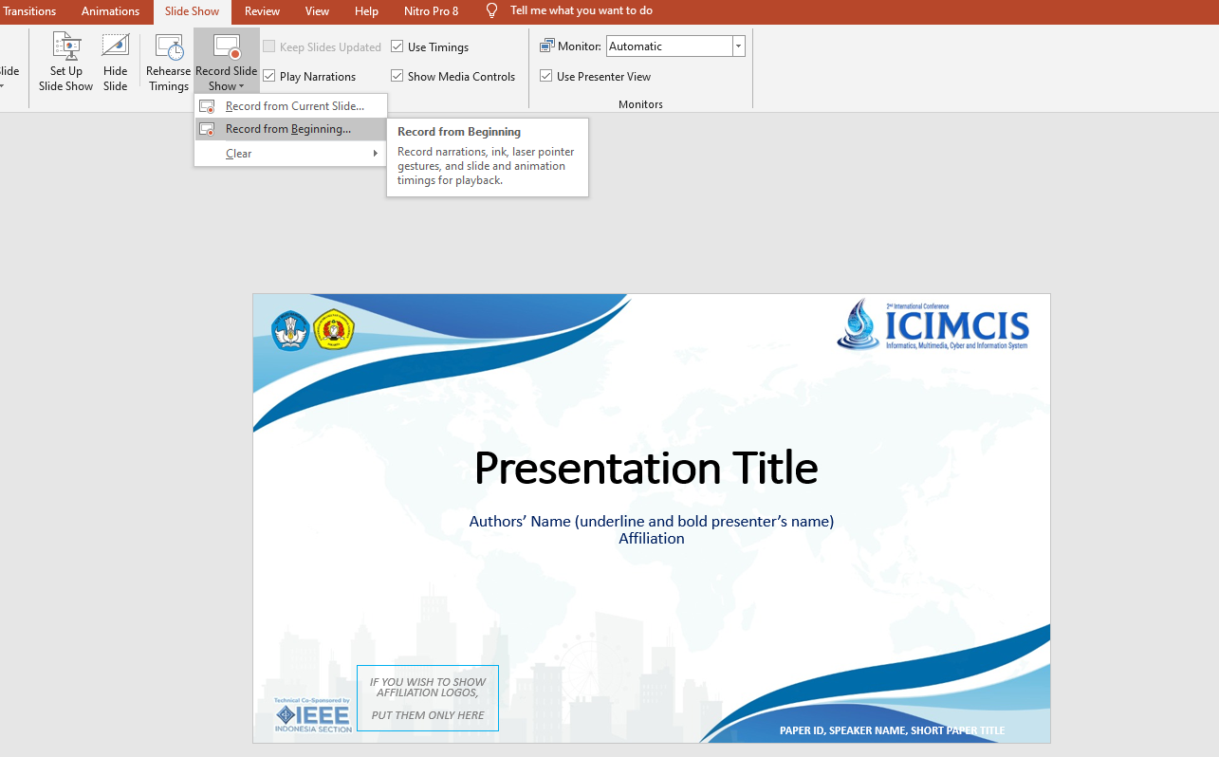
Recording Narration in MS PowerPoint 365 ctd.
1. Click on “Slide Show”
2. Click on “Record Slide Show”
3. Click on “Record from Beginning”
PAPER ID, SPEAKER NAME, SHORT PAPER TITLE

Slide 7
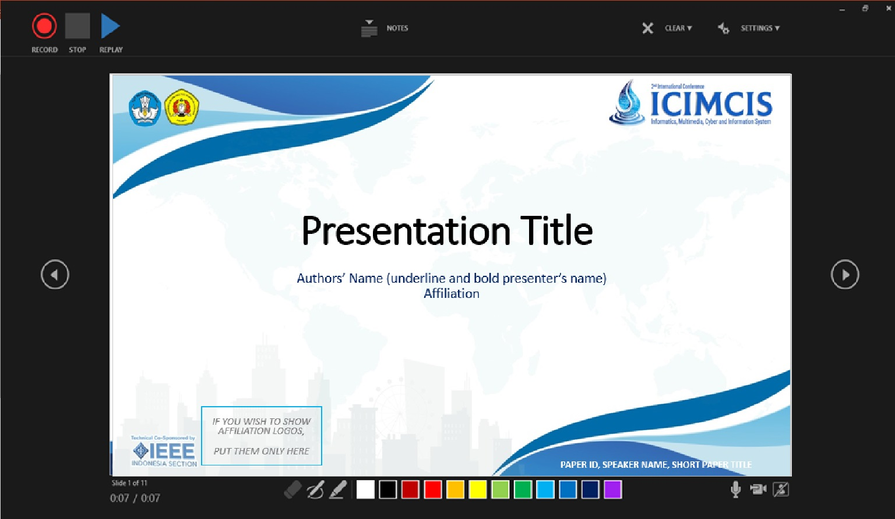

Recording Narration in MS PowerPoint 365 ctd.
5. Start recording by clicking the Red Circle
Your Video MUST be visible here
6. Stop and Resume as needed
4. Setup your Microphone and Camera
Use Pointers (if needed)
PAPER ID, SPEAKER NAME, SHORT PAPER TITLE

Slide 8
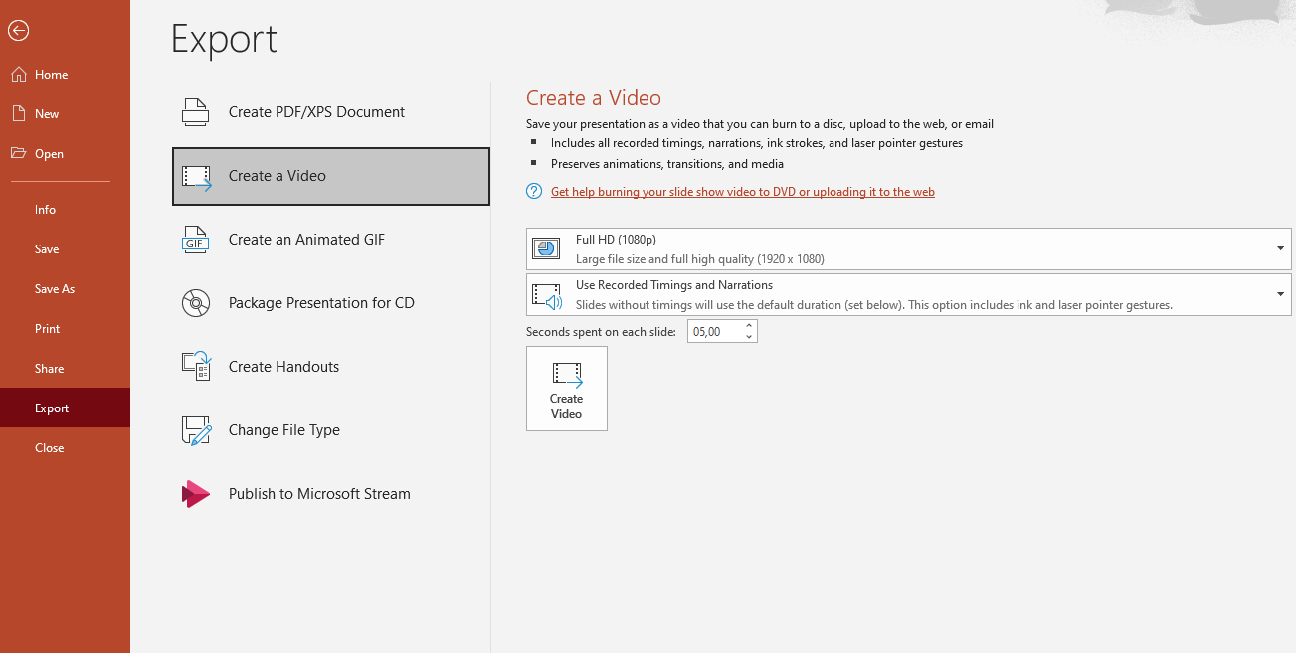
Recording Narration in MS PowerPoint 365 ctd.
9. Select “Full HD (1080P)”
8. Click on “Create a Video”
7. Click on “Export”
10. Click on “Create Video”
And save as file name “Paper ID_Video Presentation” type “Mpeg-4 Video”
PAPER ID, SPEAKER NAME, SHORT PAPER TITLE

Slide 9
Recording Narration in MS PowerPoint 365 ctd.
The authors may check the following online tutorials:
https://www.youtube.com/watch?v=yA7NTQ-dp1c&pbjreload=10
https://support.office.com/en-us/article/record-a-slide-show-with-narration-and-slide-timings-0b9502c6-5f6c-40ae-b1e7-e47d8741161c
PAPER ID, SPEAKER NAME, SHORT PAPER TITLE

Slide 10
Summary
It is better to use high contrast colors on Texts, Figures and Graphics and white background is preferred
Please try to limit number of slides and keep them as simple as possible
We request you to use larger font size: ~28 for inside the slide and ~44 for the slide title
Present the highlights, you may use bullets, not the detail
PAPER ID, SPEAKER NAME, SHORT PAPER TITLE

Slide 11
End of Presentation
Thank you
PAPER ID, SPEAKER NAME, SHORT PAPER TITLE

